Slide 1
Chair’s Report
William Paterson University of New Jersey
Faculty Senate
Tuesday, September 10, 2019

Slide 2
So…Who Are We & What Do We Do?
SENATE
hared Governance
galitarian Dialog
imble Process
ctive Participation
imely Decisions
mpowered Membership

Slide 3
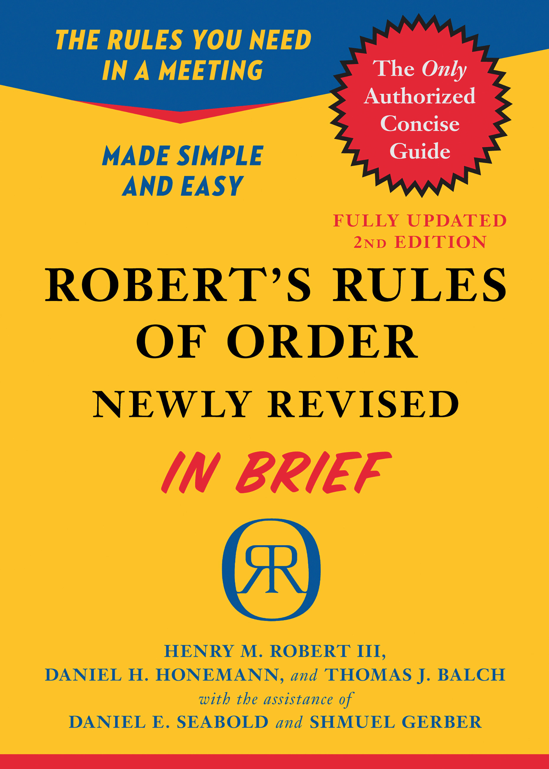
How Do We (Usually) Do It?
Order Motion Chart
Procedures At a Glance
Or…We Could…

Slide 4
Issues Discussed at SEPP (Summer 2019)
Administrator Evaluations
ART
Academic Partnerships Initiative
Travel Funds (centralization)
Boyer Model for RTP
WP101
Academic Department Consolidation

Slide 5
Academic Consolidation: Q&R
Questions
Rationale?
Implications?
Recommendations
Restructure based on WPU Mission & Core Values
Consider depts.’ histories, identities, value to WPU
Rename as ‘Consolidation without Merger’

Slide 6
Consolidation – Criteria & Metrics
5 or fewer full time faculty members
Fewer than 50 majors
Fewer than 10 graduates per year
President’s Recommendation
4. Number of minors (2 minors = 1 major)
5. UCC SCH (many small depts. >> large ones)
6. Financial contributions
Senate /Exec’s Recommendation

